Slide 1
XSS’ (cross-site scripting)
FATIMA KIYANI
MARYAM ATHER
EIMAN JAVED
HIRA NASIR

Slide 2
Details of the vulnerability AND CONCEQUENCES
Cross-Site Scripting (XSS) vulnerabilities arise due to improper handling of untrusted data within a web application. The fundamental issue is that user input is not properly validated, sanitized, or escaped before being included in the web page's output.
Consequences: XSS vulnerabilities can lead to various attacks, including session hijacking, cookie theft, defacement of websites, delivery of malware, or even complete compromise of user accounts.

Slide 3
HOW VULNERABILITY ARISES
1 Improper Input Handling:
Web applications often take user input, If the application fails to properly validate and sanitize this input, it might inadvertently include malicious code provided by an attacker.
2 Failure to Validate and Sanitize:
Validation involves checking whether the input conforms to expected formats and constraints Sanitization involves removing or encoding potentially dangerous characters

Slide 4
TYPES OF VULNERABILITIES
>Stored XSS (Persistent XSS):
>Reflected XSS (Non-Persistent XSS):
>DOM-based XSS:
Occurs when the malicious script is permanently stored on the target server and served to users when they access a particular page.
Involves the injection of a script that is included in the server's response to a particular user's request. This script is not stored on the server but is part of the response sent back to the user's browser.
This type occurs on the client side and involves the manipulation of the Document Object Model (DOM) by injecting malicious code

Slide 5
Detailed exploitation of the vulnerability
OVERVIEW:
Identifying the Vulnerability
Crafting the Malicious Payload
Injection Point
Executing Stored XSS
Executing Reflected XSS
Executing DOM-based XSS

Slide 6
Error Page XSS Attack Example Consider a traditional 404 error page that displays the URL the user attempted to access and informs the user that it does not exist. <html> <body> <? php print "Not found: " . urldecode($_SERVER["REQUEST_URI"]); ?> </body> </html>
7. Malicious Payload Examples
8. Evading Filters
9. Persistence and Automation:
10. Covering Tracks:
11.Exploitation Scenarios
12. Preventing and Mitigating XSS

Slide 7
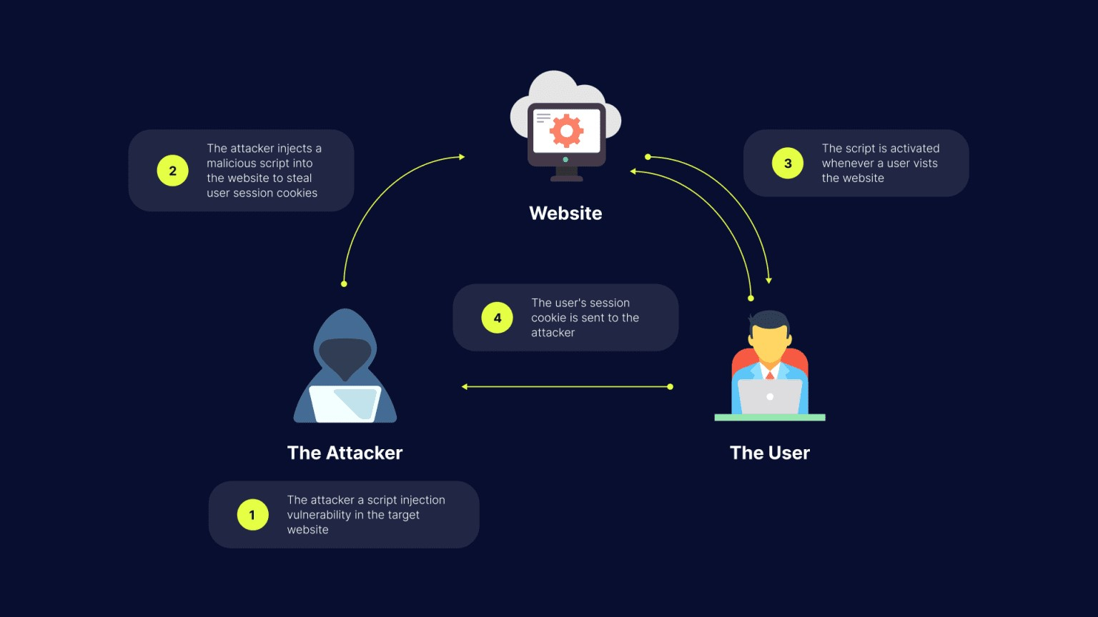

Slide 8
EXPLOITATION TOOLS
1.OWASP ZAP:
OWASP ZAP is a free and open-source web application security scanner.
Uses inactive HTTPS proxy server.
Can be used in windows,linux.
FEATURES:
Proxy mode
Spidering and crawling.
Owasp zap uses active and passive scanning modes.
Active mode: find additional vulnerabilities. real attacks
Passive mode: investigates all proxy requests and responses, but does not change the response in any way and is considered safe.

Slide 9
Usage of owasp zap
Start ZAP
Create new session
In the Attack URL text box, enter the full URL of the web application.
Select either Use traditional spider, Use ajax spider to scan.
Click attack.
Review the scan results.

Slide 10
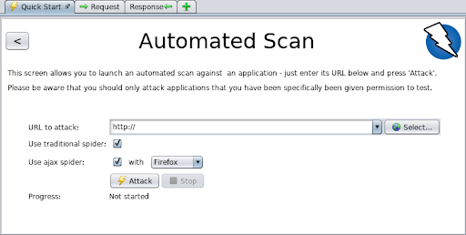

Slide 11
Burp site
Platform for performing security testing of web applications.
Testing process, initial mapping and analysis ofof an applications attack surface.
FEATURES:
Deeper manual testing
Exposes hidden attack surface.

Slide 12
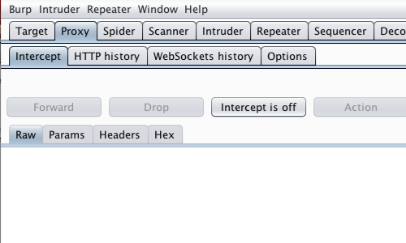
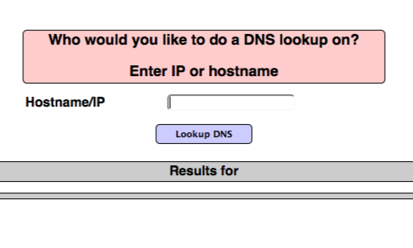
steps

Slide 13
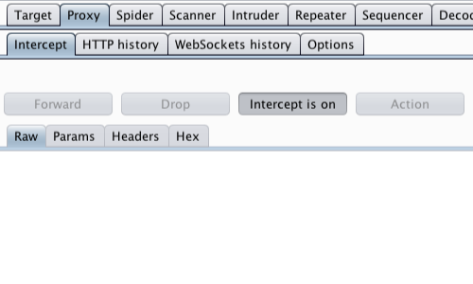
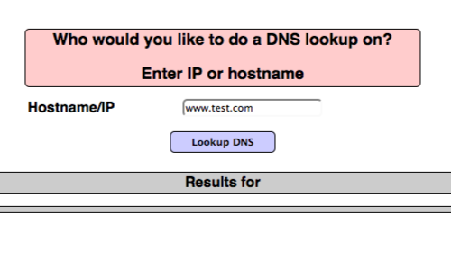
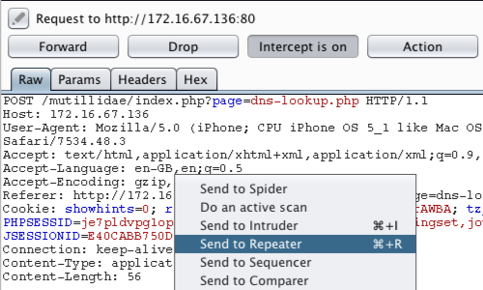
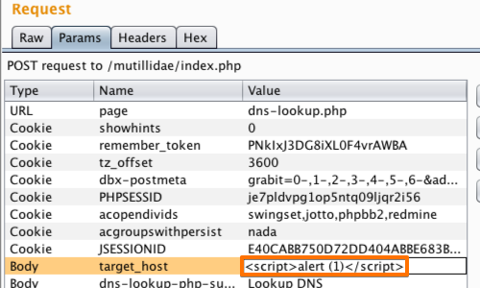

Slide 14
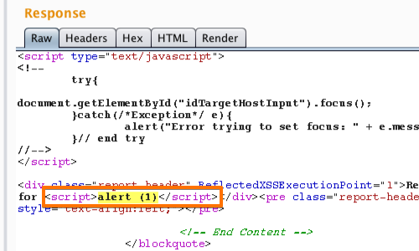
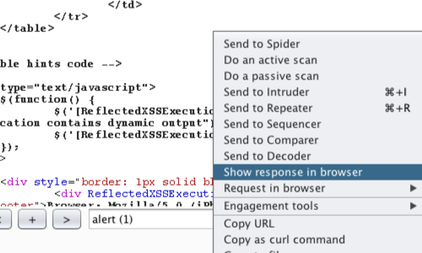
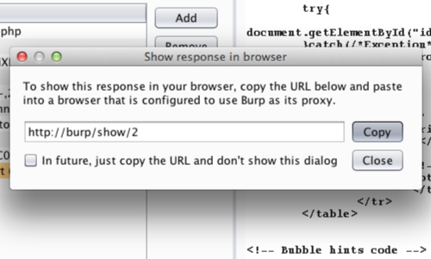
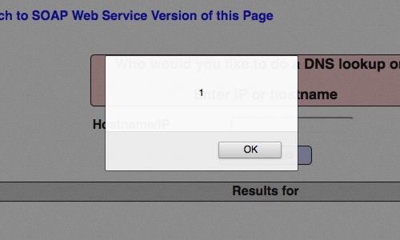

Slide 15
XSS Remediation
Remediating Cross-Site Scripting (XSS) vulnerabilities involves implementing measures to prevent attackers from injecting and executing malicious scripts on a web application.
The remediation of XSS vulnerabilities is heavily context-dependent and the patches vary.

Slide 16
Input Validation
Server-Side Input Validation
Validate all user inputs on the server side.
2)Use Whitelisting
Employ a whitelist approach for input validation.
Output Encoding
HTML Entity Encoding
Encode user-generated content before rendering it in HTML
2)JavaScript String Encoding
If user-generated content is included within JavaScript, encode it using JavaScript
3)URL Encoding
If user-generated content is used in URLs, ensure that it is properly URL-encoded

Slide 17

Use Content Security Policy (CSP)
Implement a Strong Content Security Policy
Configure and enforce a Content Security Policy (CSP) header in your web server or within your HTML.
This example allows scripts to be executed only from the same origin.

Slide 18

Example;
Untrusted URL
Example

Slide 19
THANK YOU
☺

